Slide 1

Smart Hospital Patient Management System
Technologies Used:
C++, HTML, CSS, JavaScript
Presented by:
Zoha Shakeel (f24610030)
Maheen Masood (f24610044)
Submitted to :
Maam Tabinda Nasir
Subject: Data Structure Algorithm

Slide 2
Introduction
Hospitals need proper patient management.
Emergency patients must be treated first.
Manual systems cause delays and mistakes.
This project manages emergency and normal patients.
It uses data structures and algorithms.
Emergency patients get priority treatment.
Patient records are stored properly.
A simple frontend makes the system easy to use.

Slide 3

Problem Statement
Hospitals face many problems such as:
Emergency patients are not treated first.
Normal patient queues are not managed properly.
Patient records are hard to store and search.
Manual systems increase waiting time.
Therefore, an automated system is required.

Slide 4




Objectives
Emergency Priority
Normal Patient Flow
Efficient emergency patient management using priority queue (max-heap)
Manage normal patients in a FIFO queue (linked list).
Rapid Record Access
Operational Analytics
Maintain patient records using a hash table for fast search, update, and delete
Provide analytics: total patients treated, average waiting time

Slide 5

Project Scope & Limitation
Scope of the Project
Applicable to small to medium hospitals or clinics.
Managing emergency and normal patients separately.
Giving priority to emergency patients.
Storing and searching patient records easily.
Providing a simple web-based interface.
Limitations:
No database is used.
Suitable for learning and small-scale use

Slide 6
Methodology: The Interactive Workflow
The project follows a modular and interactive approach:
1.Patient Entry: User enters patient ID, name, and priority (if emergency)
2.Queue Assignment:
Emergency patients → PriorityQueue (Max-Heap)
Normal patient → NormalQueue (Linked List)
3.Treatment: System treats the next patient based on priority.
4.Record Keeping:
Stores patient information in a HashTable for quick search/update.
Tracks arrival time and treatment time to calculate waiting time.
5.Reporting:
Generates analytics report: total patients treated, average waiting time

Slide 7

Algorithms Used
Emergency Queue (Priority Queue)
Patient Records (Hash Table)
Insertion: Place patient in heap; bubble up to maintain max-heap property.
Insert/Search/Update/Delete: Use patient ID as key; hash to index; store in linked list at that index
Treatment: Extract max from heap; bubble down to
maintain heap.
Wait Time Calculation
Wait Time = Treatment Time - Arrival Time
Normal Queue (First-In, First-Out)
Enqueue: Add patient at rear.
Dequeue: Remove patient from front.

Slide 8
Data Structures Used
Features
Data Structure
Reason
Emergency Queue
Max-Heap
Quickly fetch highest-priority patient
Normal Queue
Singly Linked List
FIFO order for normal patients.
Patient Records
Hash Table (Separate Chaining)
Fast insert/search/update/delete
Wait Times
Vector
Store wait times for analytics

Slide 9
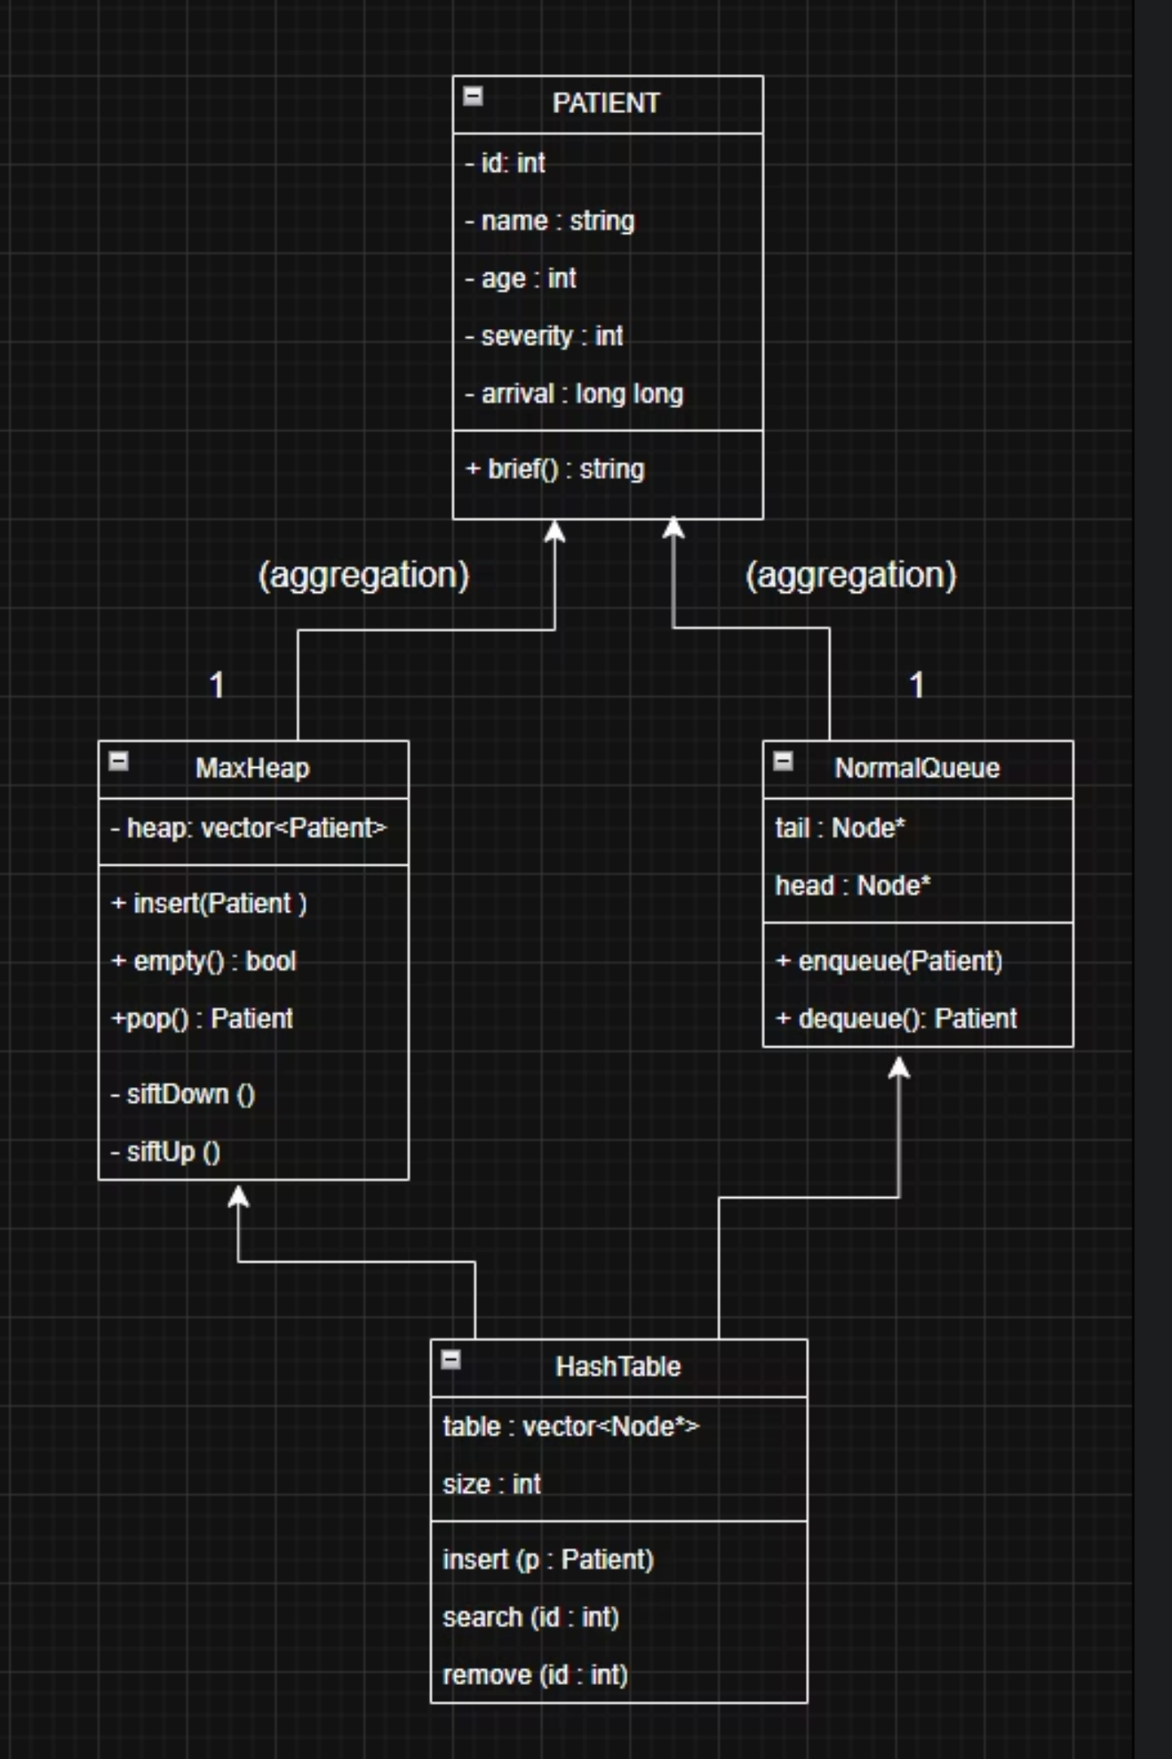
System Architecture:
The UML shows how the system manages patients. Emergency patients go to the MaxHeap, normal patients to the NormalQueue, and all records are stored in the HashTable for fast access. HospitalSystem controls everything and calculates wait times

Slide 10



Sample Output & Key Analytics
Sample console output for treated patient:
Treated Patient Console Output
Administrative Analytics Report
--- Patient Treated ---
ID: 101
Name: John Doe
Priority: 8
Arrival: Mon Dec 23 11:45:32 2025
Treatment: Mon Dec 23 11:50:12 2025
Wait time (seconds): 280.00
--- Analytics Report ---
Total patients treated: 25
Average wait time (seconds): 312.45

Slide 11
Future Work & Reference
Future Work
In the future, the system can be improved by:
Adding a database.
Showing graphs and analytics.
Adding user roles.
Making a mobile version.
References
C++ Documentation
Data Structures and Algorithms – Course Notesw3.school
“Priority Queue, Hash Table, Linked List”
MDN Web Docs – HTML, CSS, JavaScript
Hospital Management System Articles
System Architecture –draw.io

